Slide 1
LOGO PITCH
EARTH STRIKE
by hPerks

Slide 2
WHAT WE NEED IN A LOGO
Our ideal logo should:
be unique
be easily recognizable
be simple, easy to draw
encompass the essence of our movement
be inspiring; enflame the passions

Slide 3

ISSUES WITH PREVIOUS LOGOS
Our current logo has decent symbolism, but it is messy, complicated, and a bit generic. As Carlo pointed out, there is no consistent design, the globe & hand-shaking is very clichéd, and the logo does not scale well to small sizes.
It’s not bad for 20 minutes in Paint.NET, but we can do better.

Slide 4

ISSUES WITH PREVIOUS LOGOS
Carlo’s proposed logo is very well-designed, scalable and recognizable. For any other environmentalist group, it would be perfect – but the symbolism of the megaphone conflicts directly with the core purpose of our movement: a global general strike.
The principle of “actions not words” is our raison d’être, and we can’t afford to lose that essential part of our message.

Slide 5

NEW LOGO

Slide 6

EXPLANATION
The match symbolizes the “strike”, and the flame / leaf symbolizes the environment. Together, they symbolize the spark that we hope to set off with our general strike.
This logo is unique, easily recognizable, scalable, and far easier to stencil than any previous suggestions. It works in monochrome and colour, and it can be drawn minimalistically in only a couple seconds.

Slide 7


ASSETS
EMBLEM
ICON / STENCIL

Slide 8
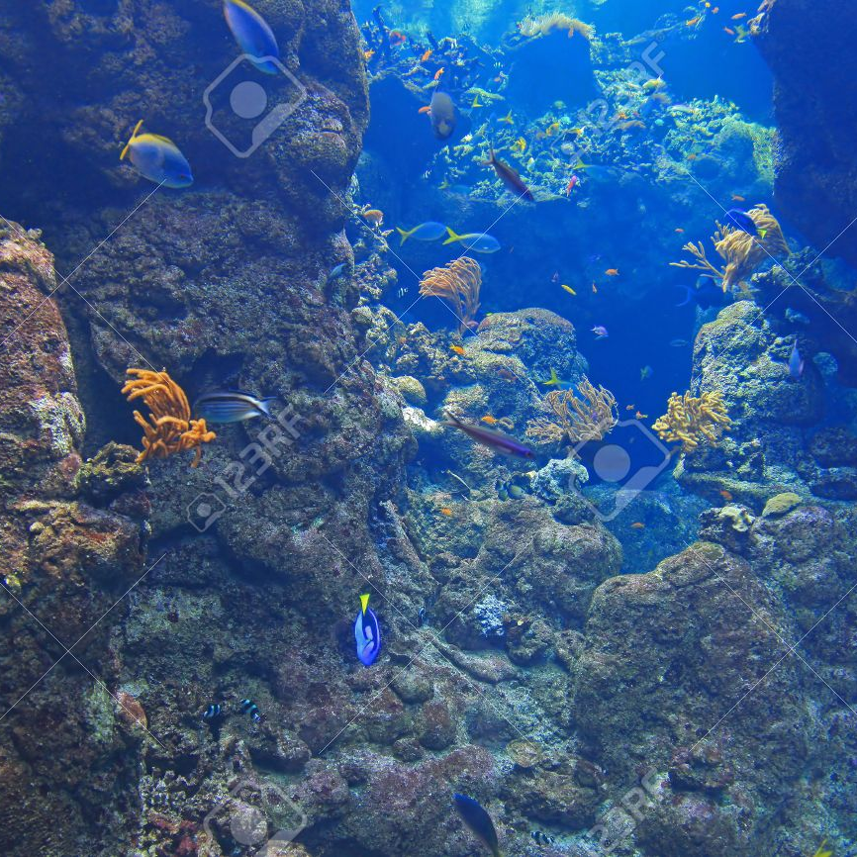
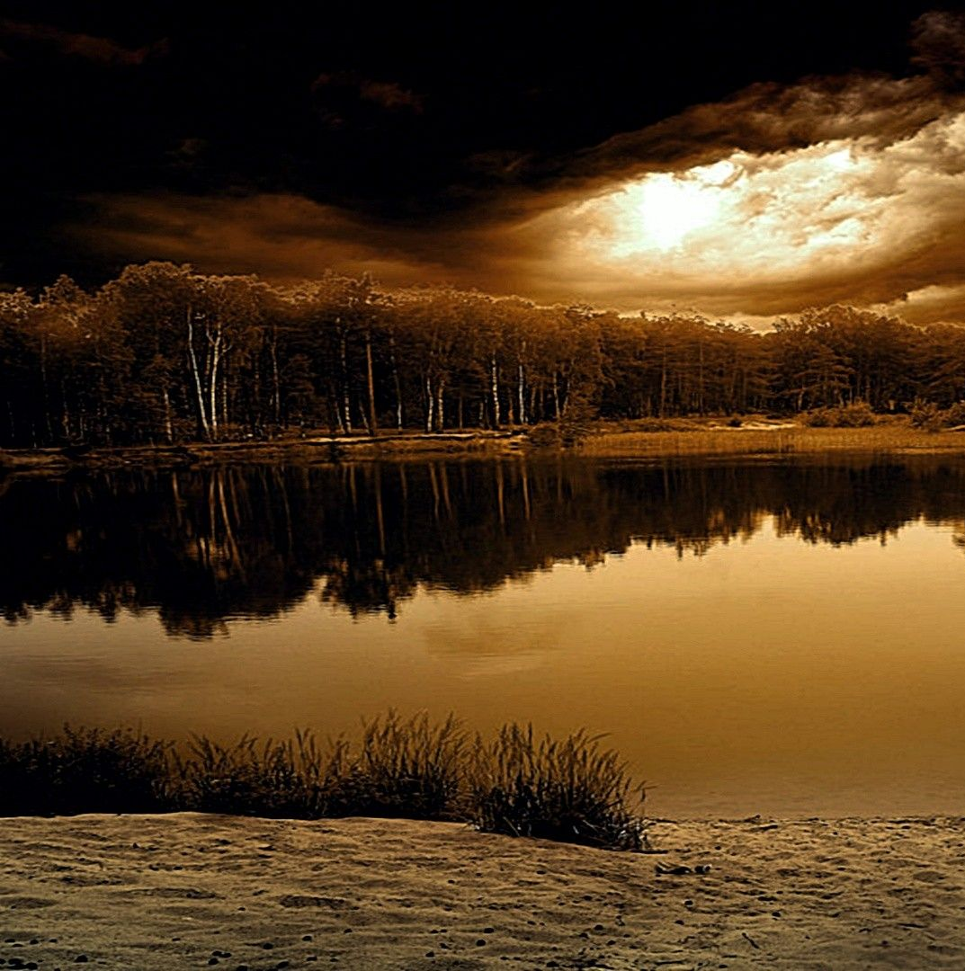
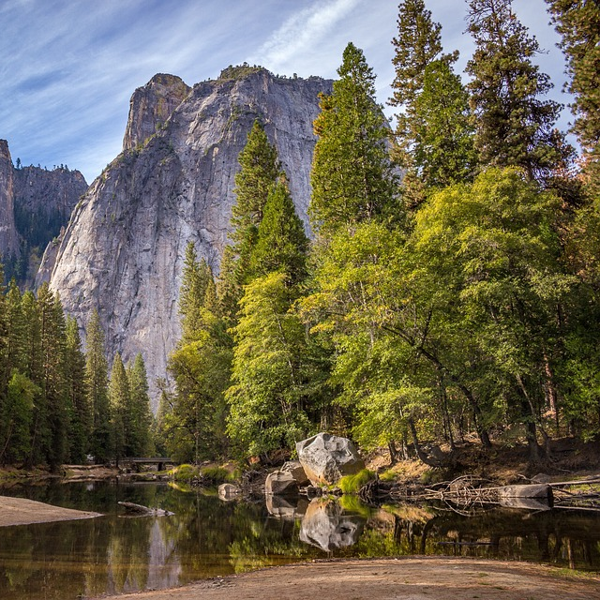
EXAMPLES

Slide 9

ADAPTING THE LOGO
The text, like in Carlo’s logo, is good for clarity and will be changed by local campaigns. However, the leaf and matchstick also provide opportunities for customization.
Many countries have national trees, whose leaves lend themselves nicely to the logo. The matchstick can also be coloured differently, either with one or two colours for its two sides, based on colours of the country’s flag.

